Slide 1
Zero pollution
Climate ambition
Biodiversity
Energy
A European Green Deal
Food
Circular economy
Mobility
Building

Slide 2
Food
Reward farmers for sustainable practices
Reduce impact of food processing and retail
Combat food waste
Reduce chemical, pesticide, fertilizer use

Slide 3
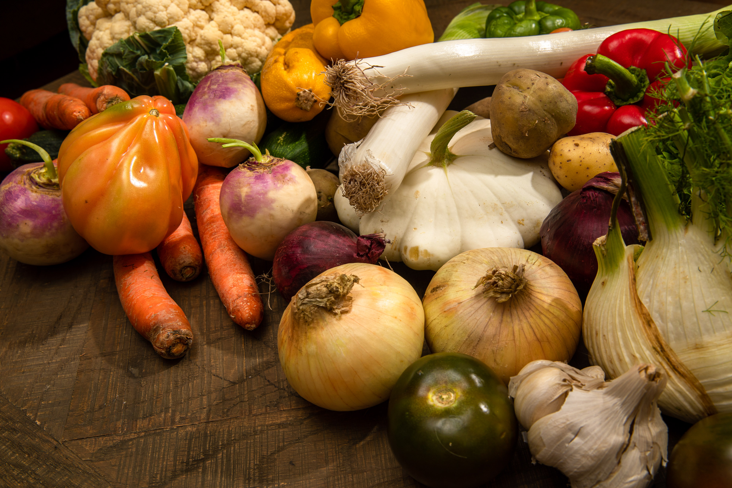
Reward farmers for sustainable practices
Farm to Fork strategy
  Protect people’s health and wellbeing, foster nature and biodiversity, increase EU competitiveness and resilience
Preserve the work of farmers
Sustainable practices in agriculture and fisheries→ reward farmers for better environmental performances
Expand organic farming practices to at least 25% of farmland

Slide 4
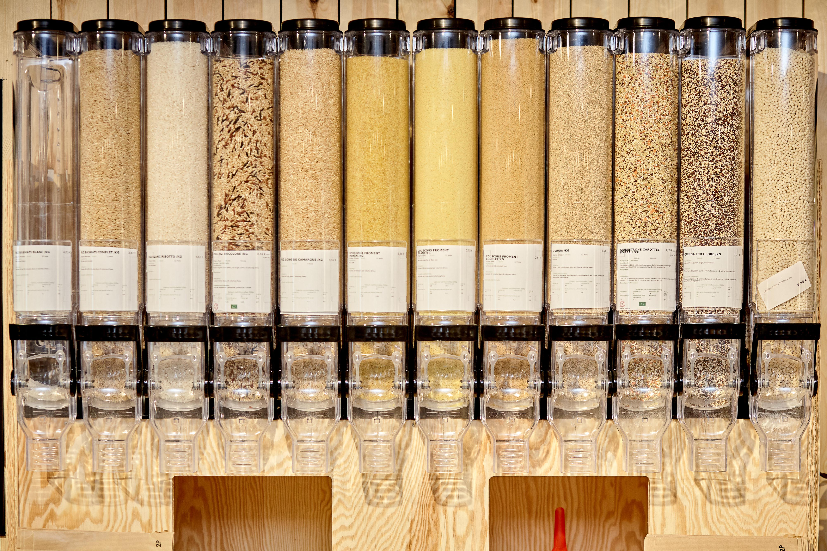
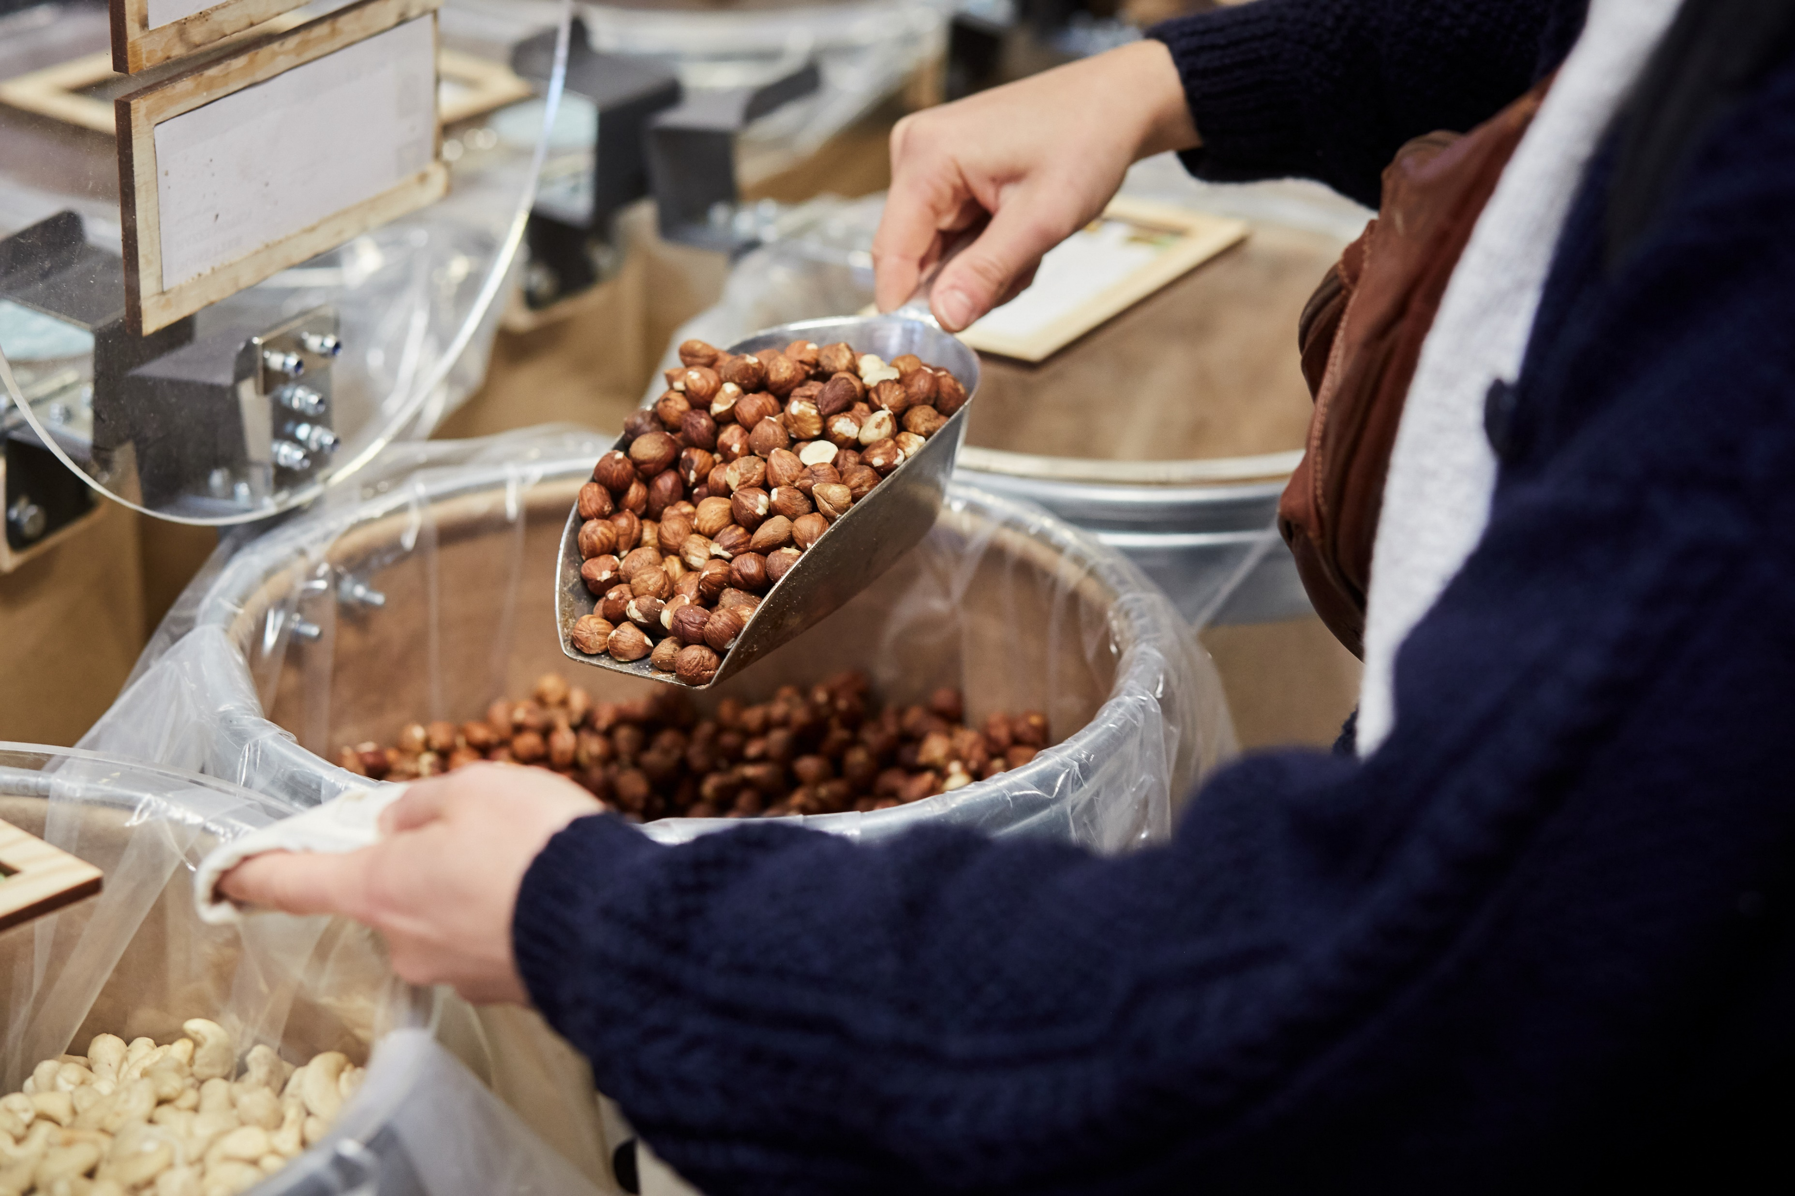
Reduce impact of food processing & retail
Circular economy principles
Reduce environmental impact of food:
  Transport
  Storage
  Packaging
Combat food waste through informing and educating consumers
  Commission will propose legally binding targets to halve food waste by 2030

Slide 5
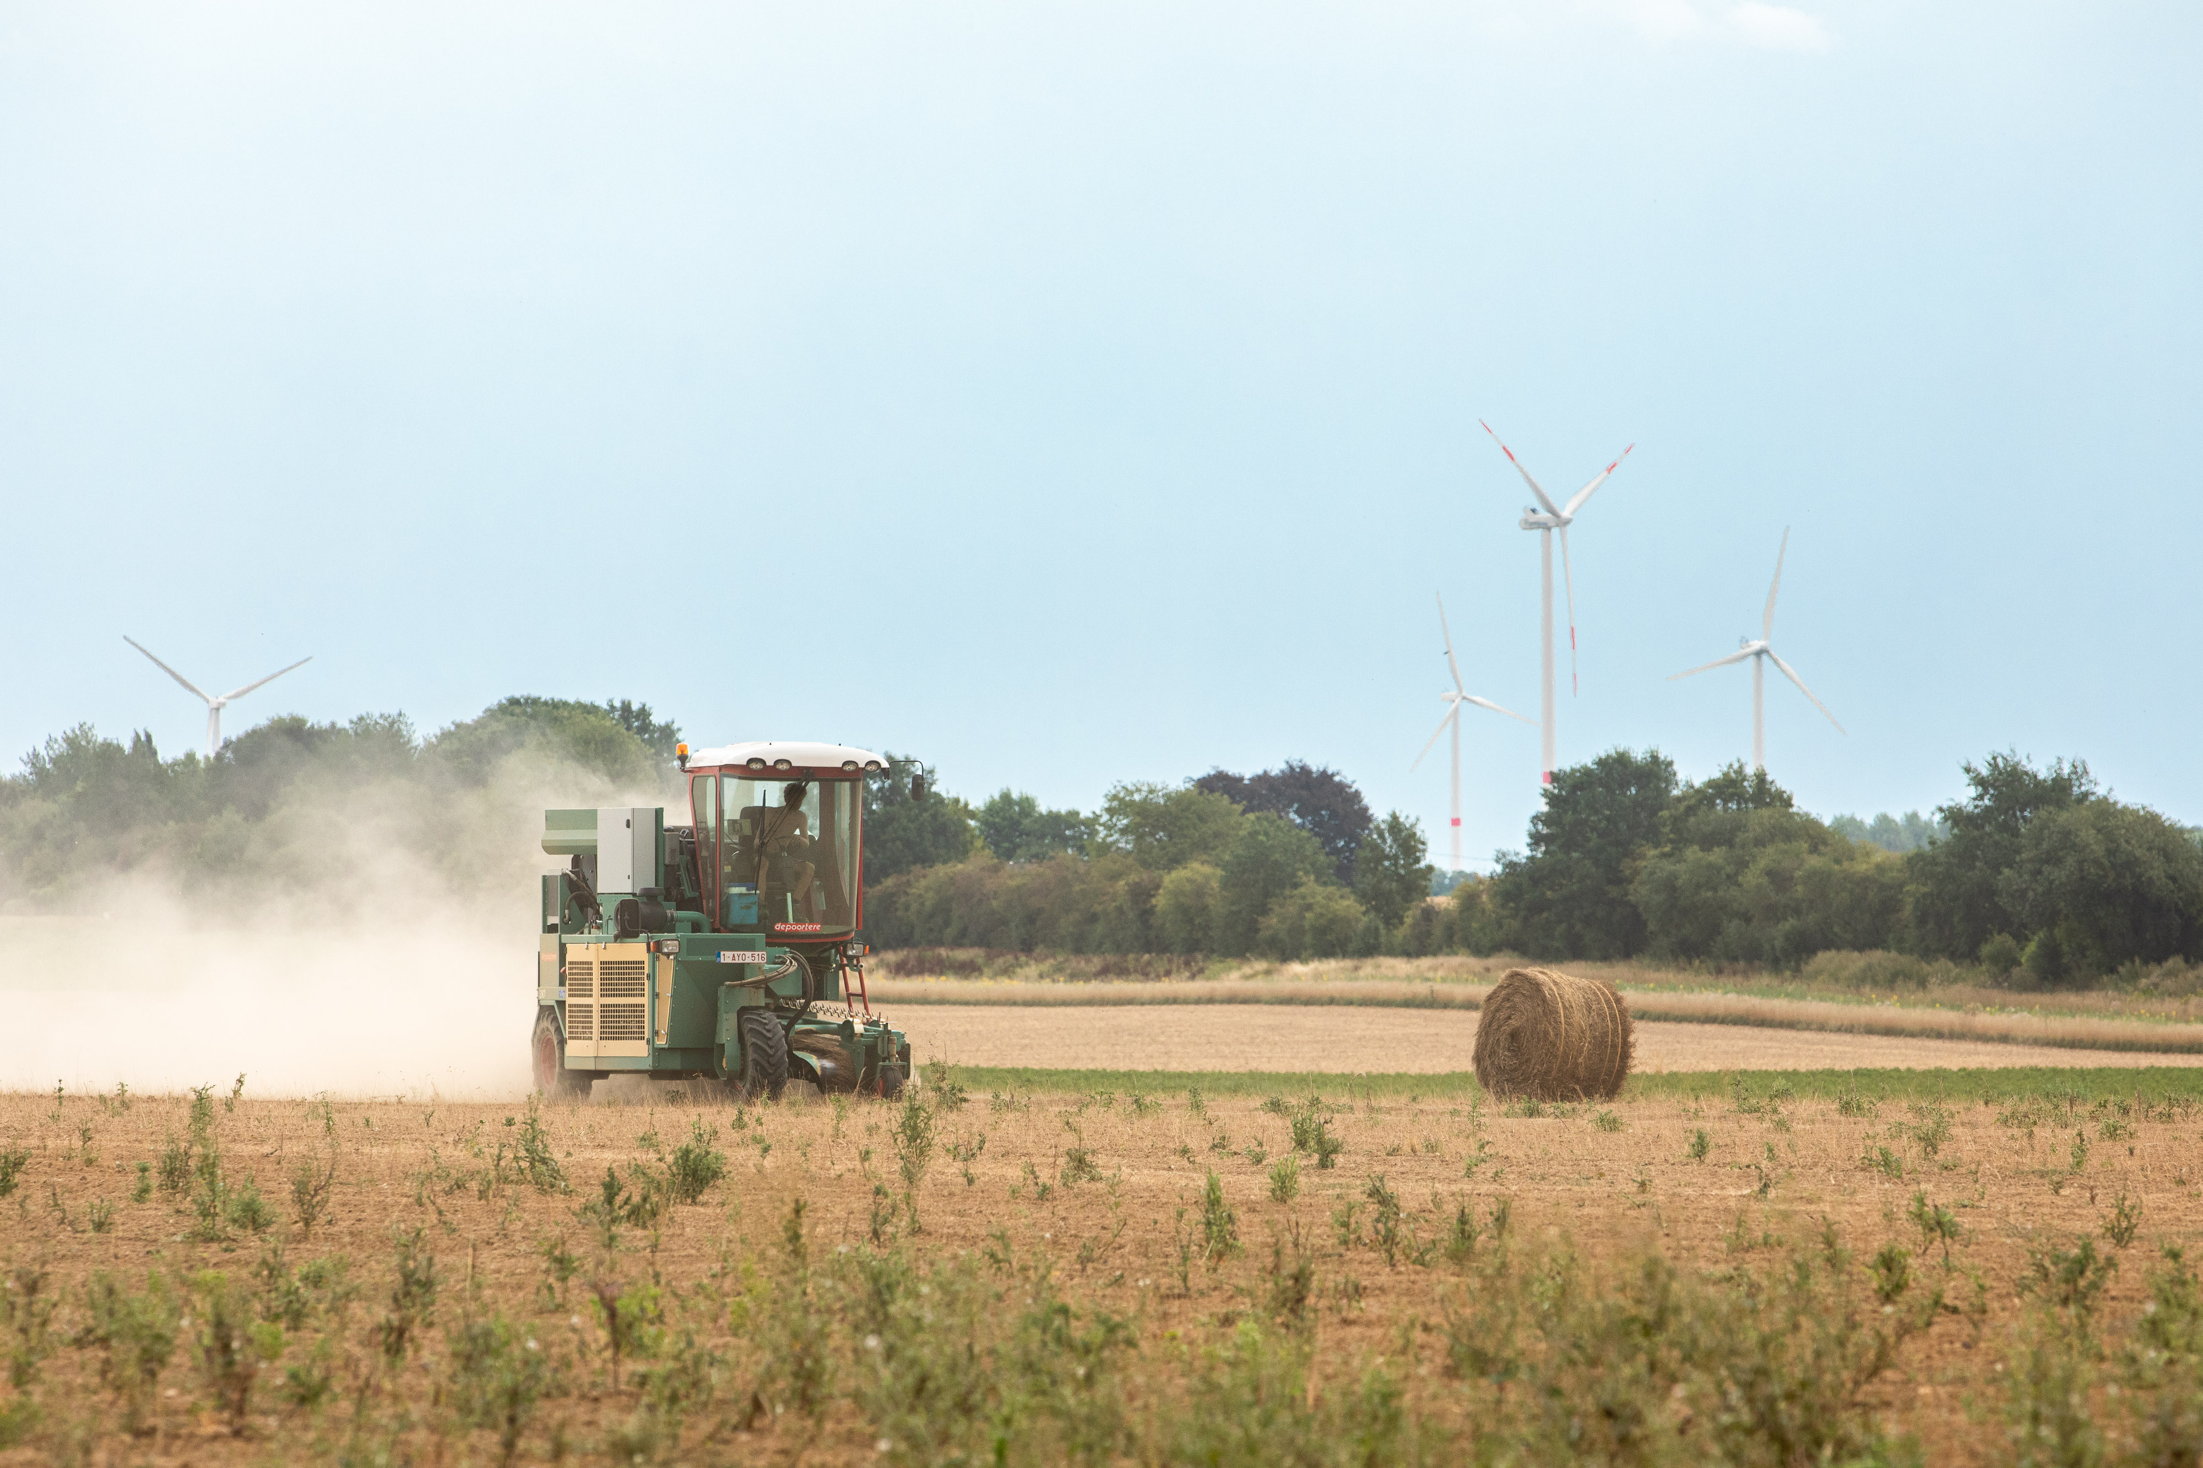
Reduce chemical, pesticide, fertilizer use
Reduce use of chemical and hazardous pesticides by 50% by 2030
Reduce fertilizer use by 20% by 2030 to reduce loss of nutrients in soil
Reduce sale of antimicrobials for farm animals/aquaculture by 50% by 2030 to tackle antimicrobial resistance

Slide 6
Biodiversity
Halting biodiversity loss
Improving forest ecosystems
Fostering healthy and resilient oceans

Slide 7
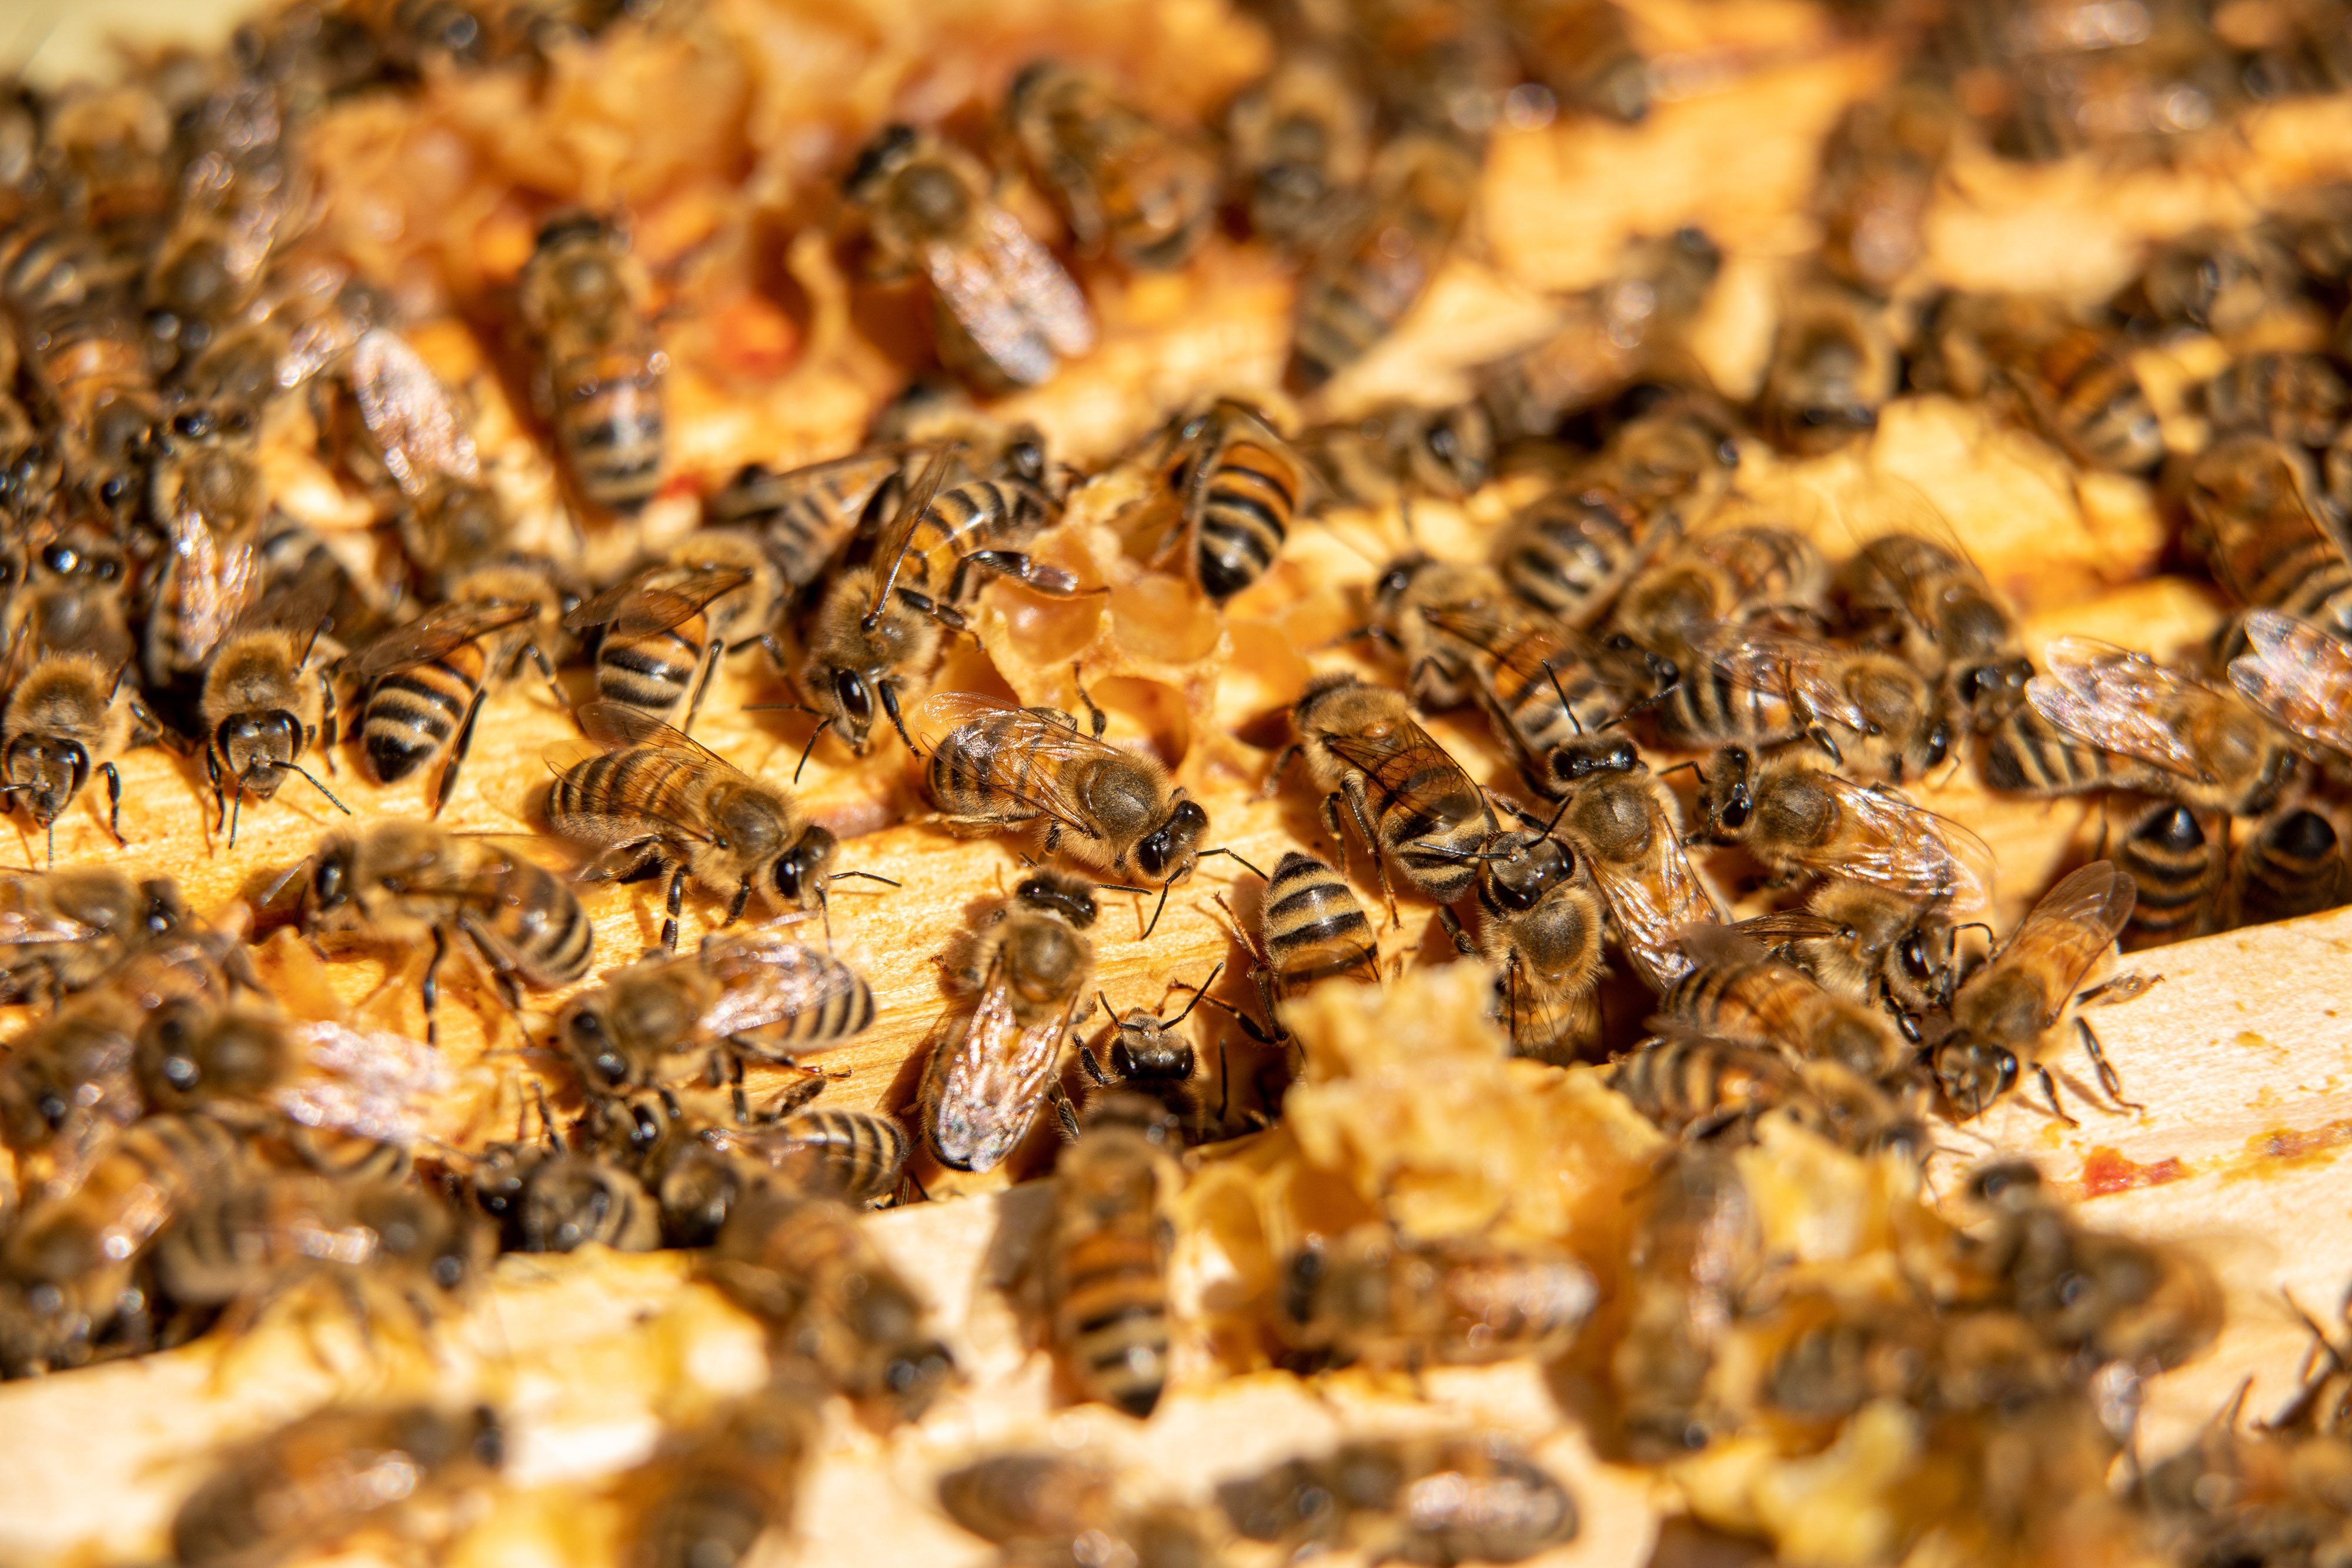
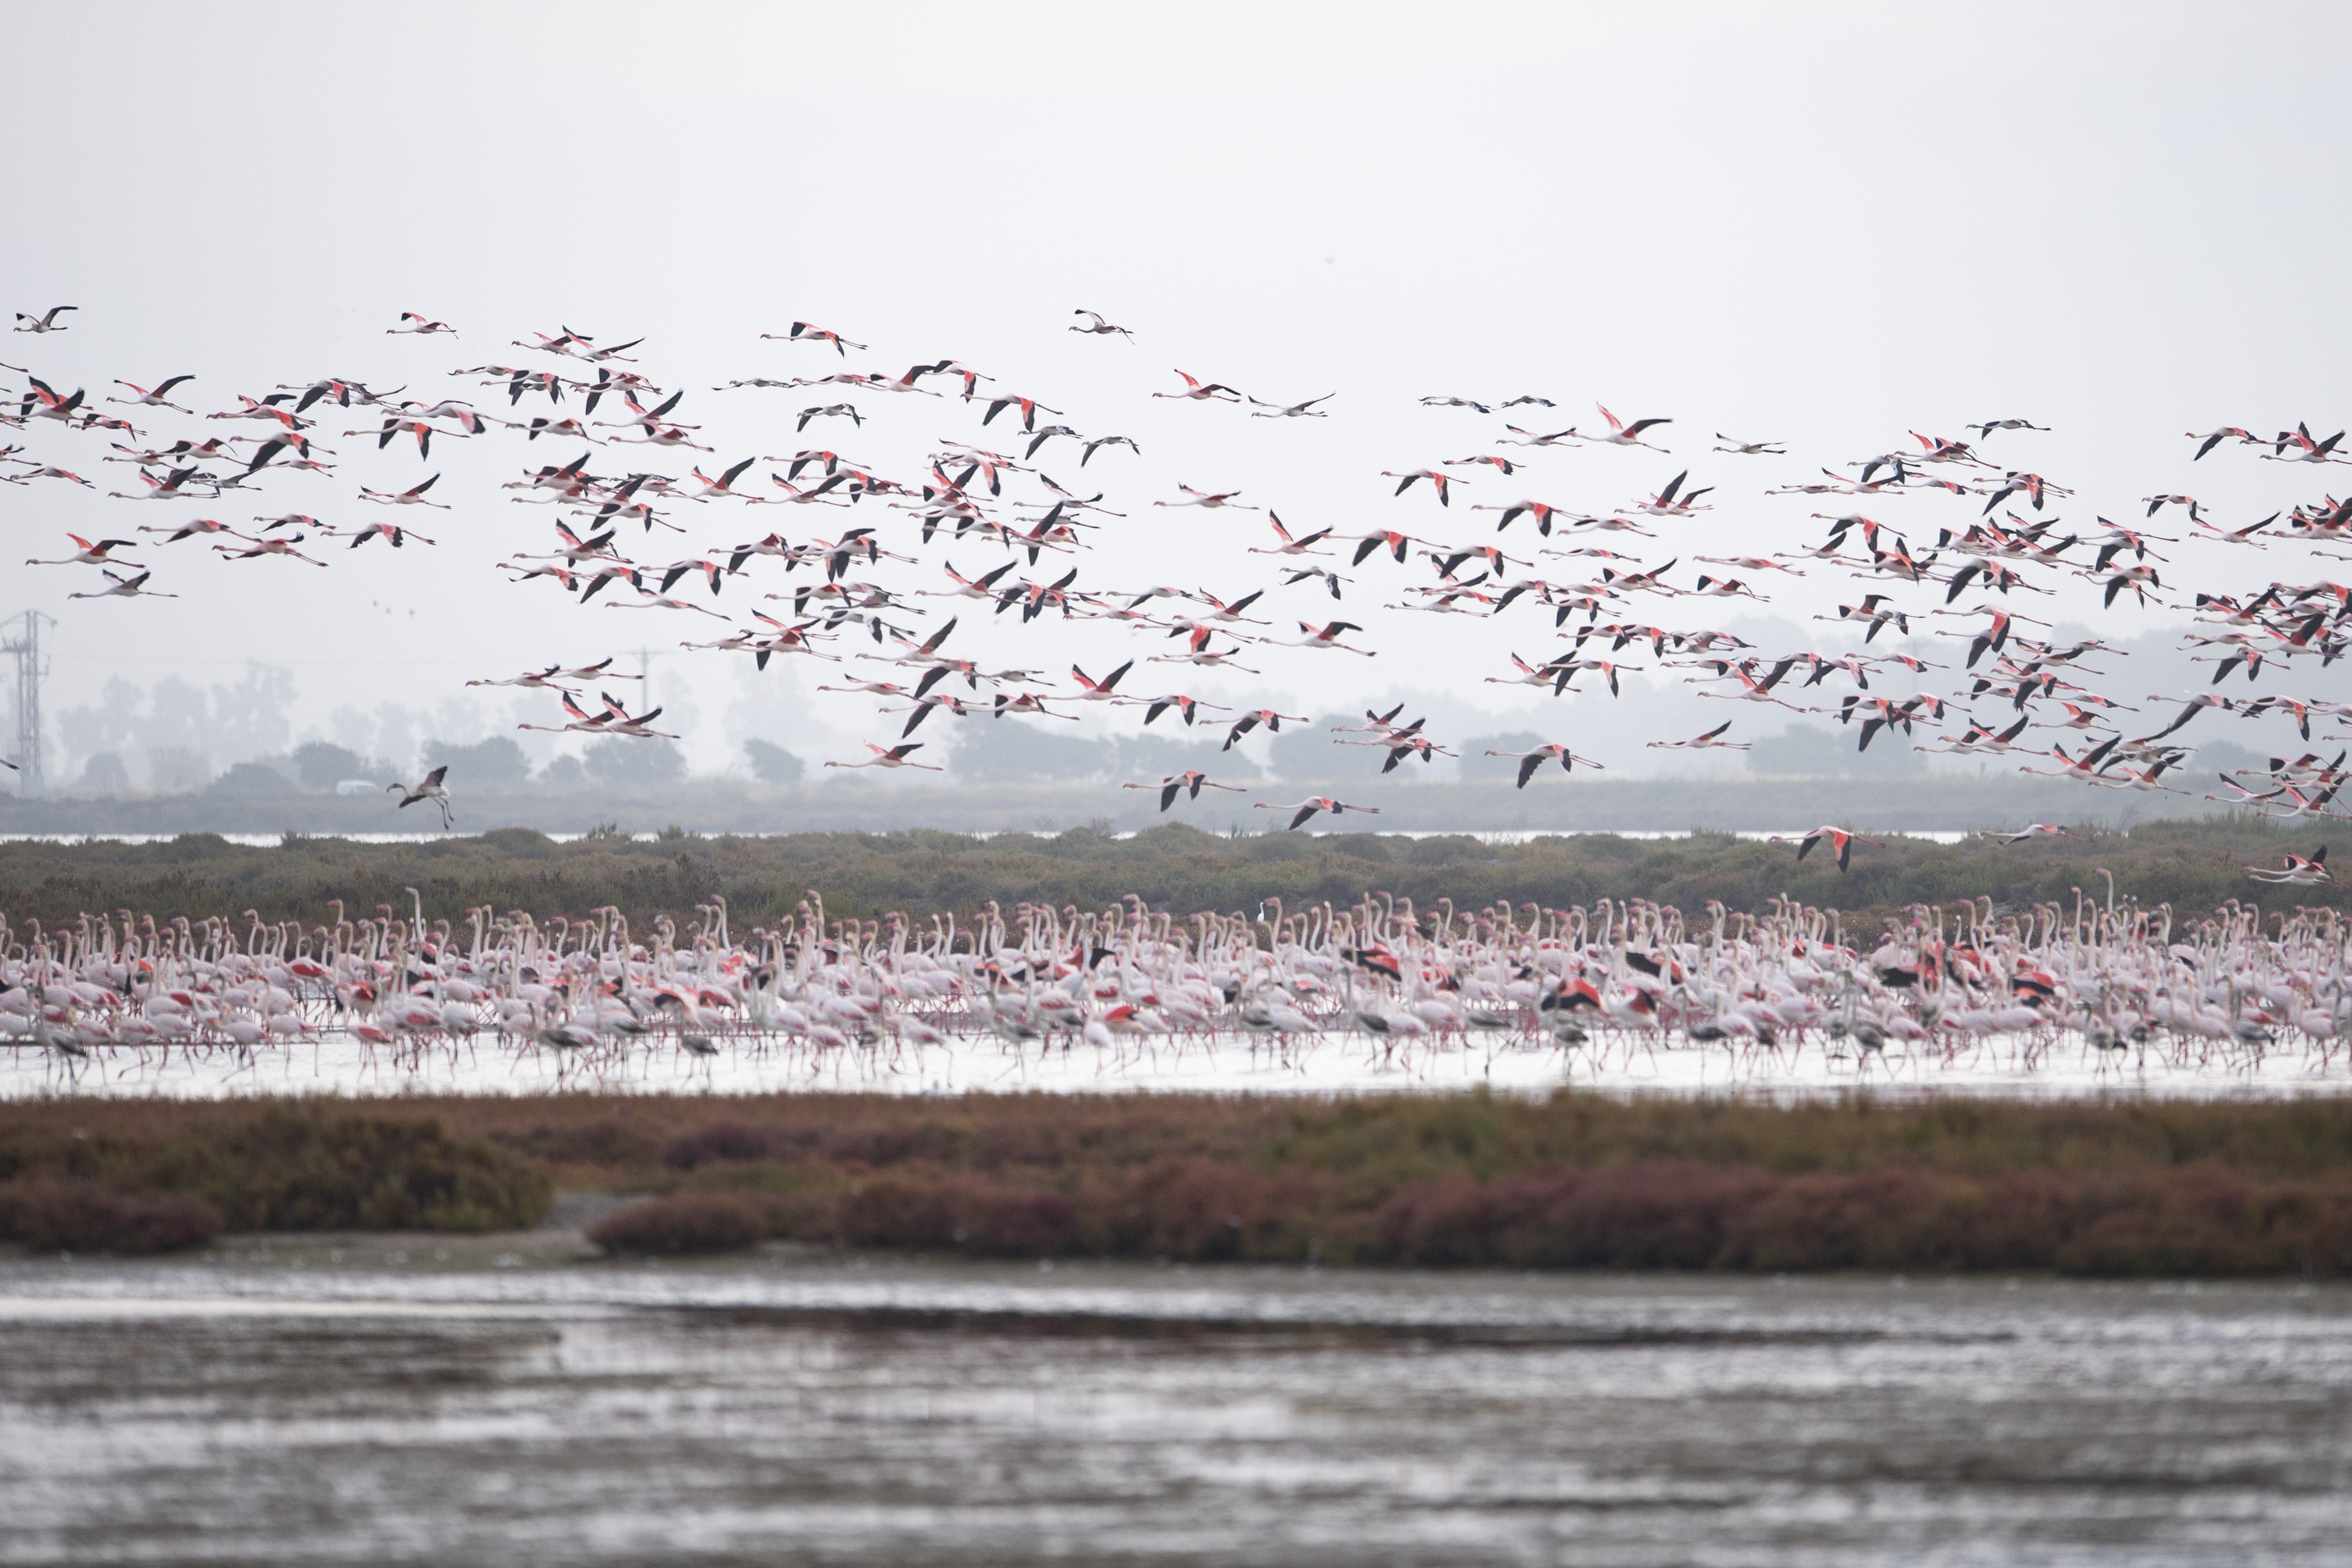
Halting biodiversity loss
EU Biodiversity Strategy for 2030 proposed by Commission in June 2020
  Expand network of protected areas in the EU, building upon Natura 2000 areas
  EU Nature Restoration plan: specific actions to restore damaged ecosystems & measures to manage them sustainably
  Strengthened governance framework to ensure respect of nature in decision-making process
  Convention on Biological Diversity: tackle the global challenge

Slide 8
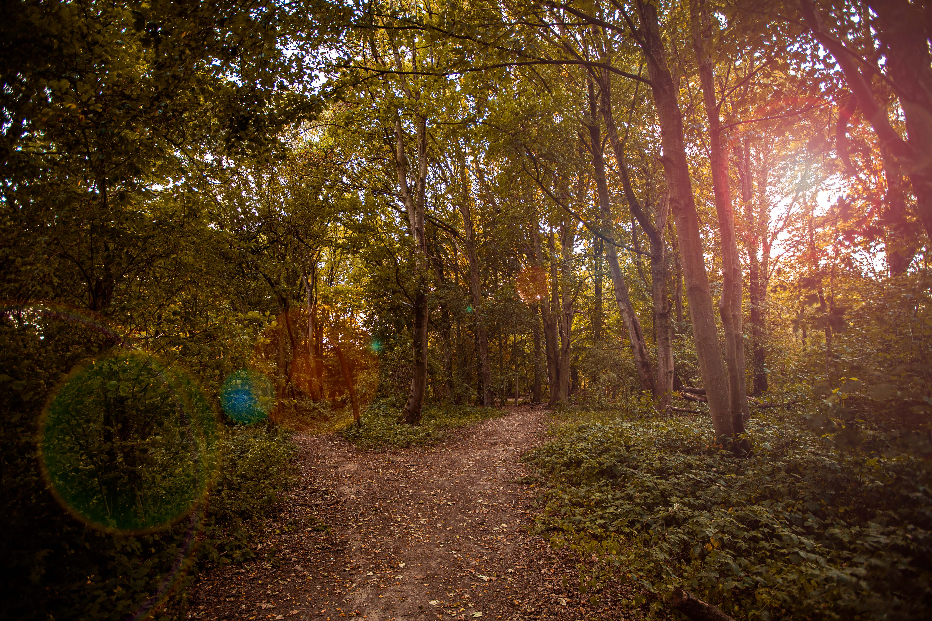
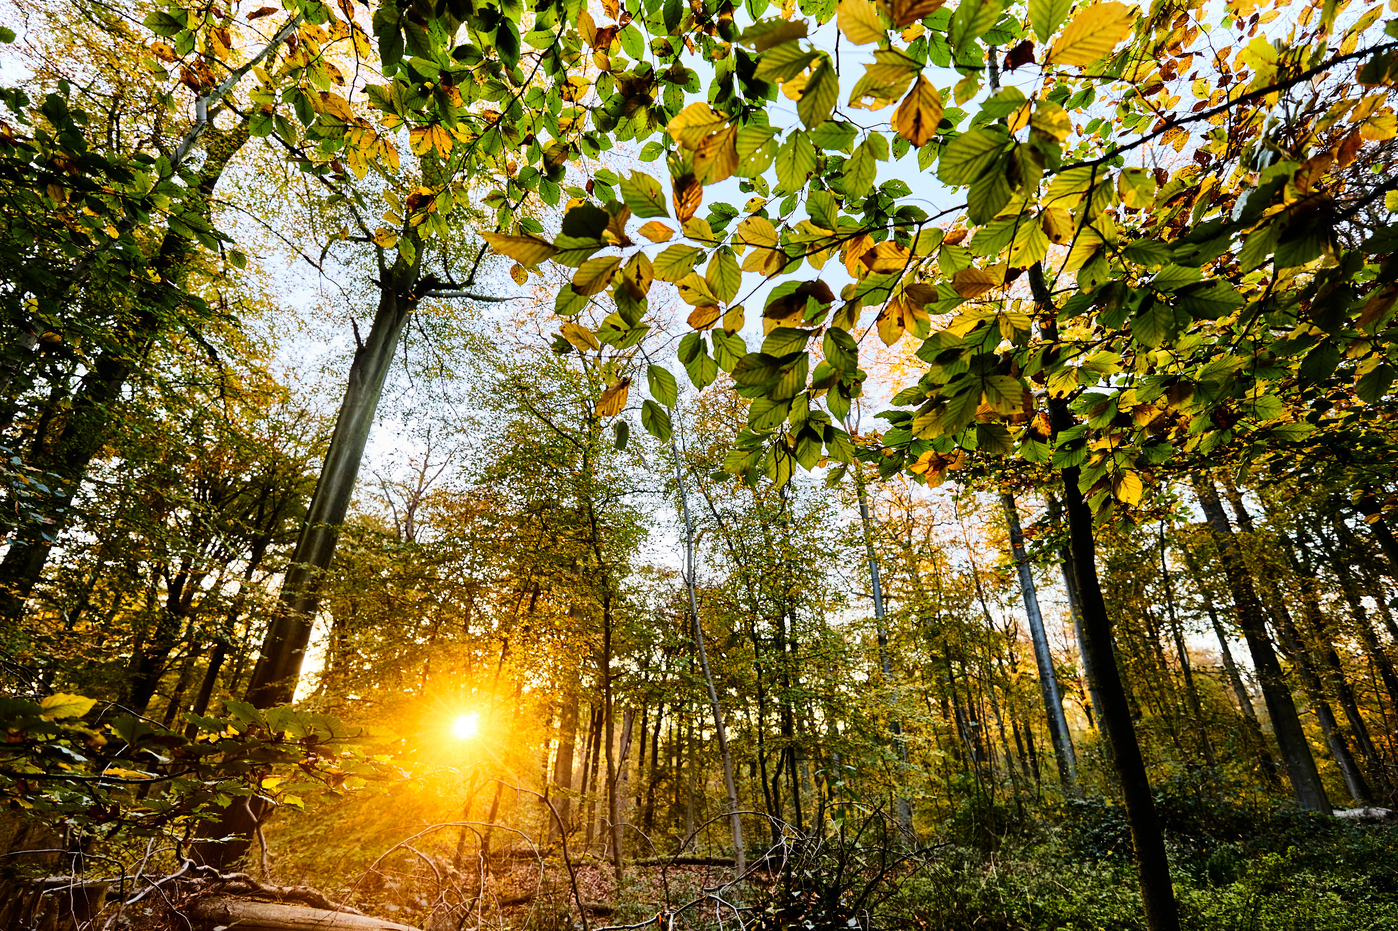
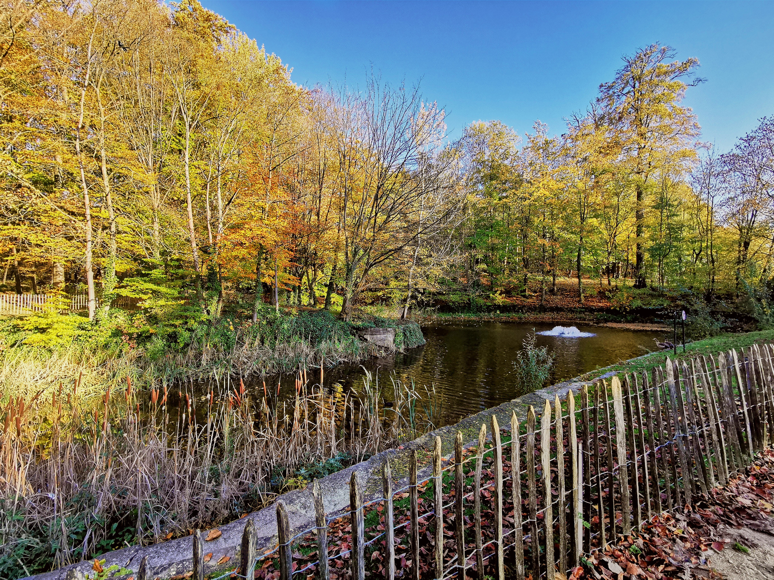
Improving forest ecosystems
Forested areas are crucial to achieve climate neutrality
Preservation and restoration of forest is essential for absorbing CO2 and promoting the bioeconomy

Slide 9
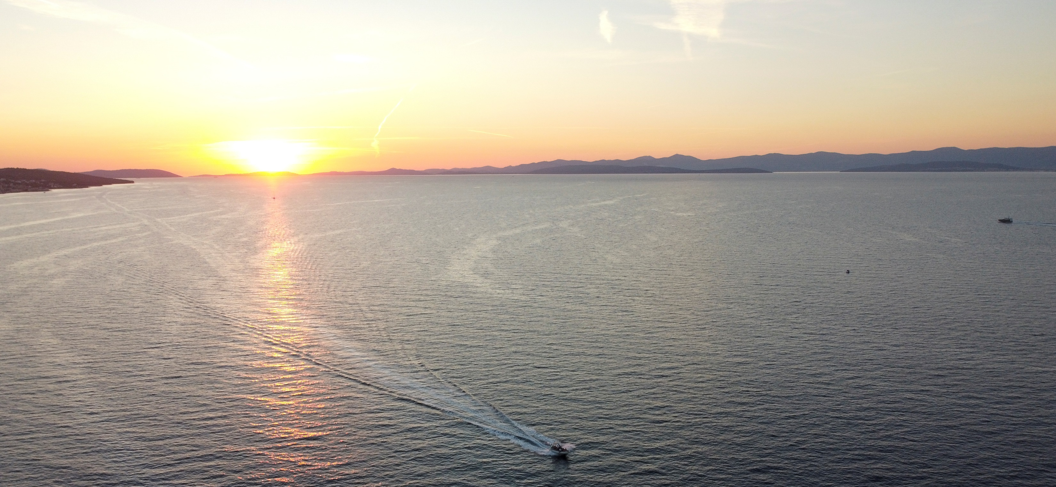
Fostering healthy and resilient oceans
A sustainable blue economy
Oceans can help alleviate demands on land resources
Oceans can provide space for offshore renewable energy

Slide 10
Zero pollution
Toxic-free environment
Tackle air, water and soil pollution
Protect citizens and environment from hazardous chemicals

Slide 11
Toxic-free environment
To be proposed in 2021: Zero pollution action plan for air, water and soil
Improve monitoring, reporting, prevention and remedying of all forms of pollution
Review air quality standards in line with WHO guidelines
Reducing greenhouse gas emissions to contribute to cleaner air, focusing on tackling industrial installation pollution
Reducing water and soil pollution from overfertilization, micro-plastics, pharmaceuticals

Slide 12
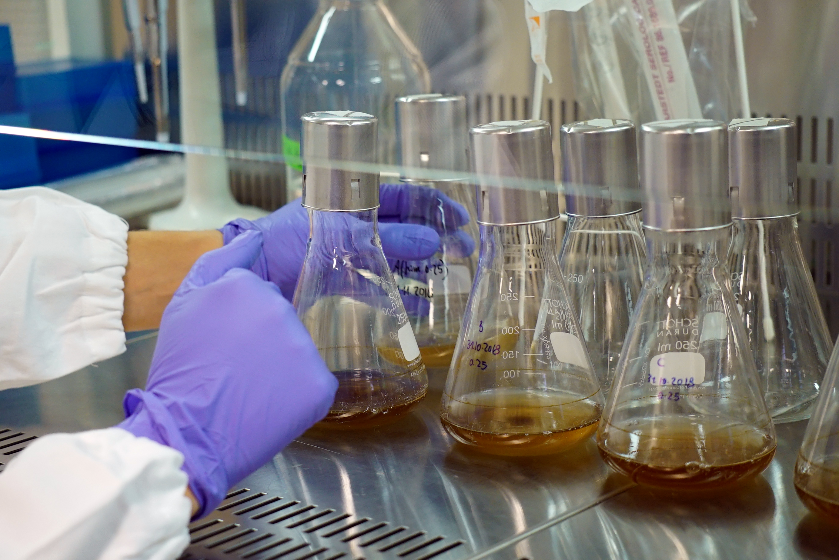
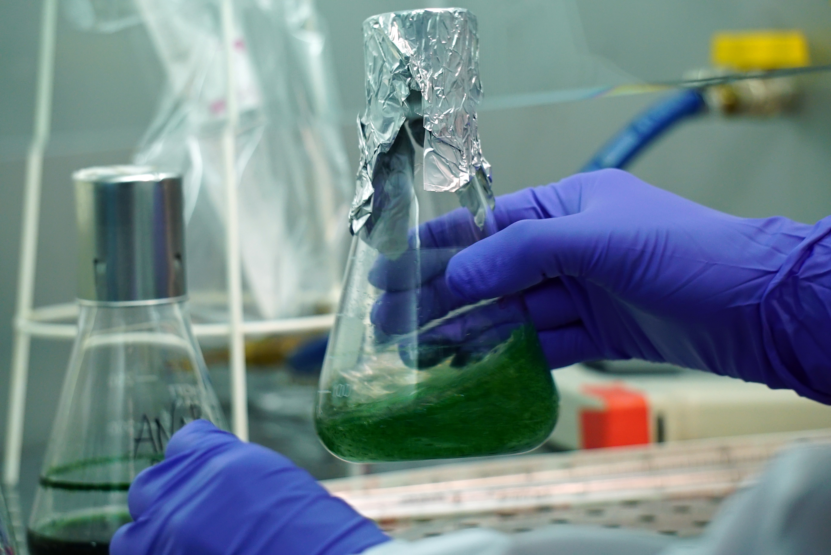
Protect citizens & environment from hazardous chemicals
Chemicals strategy for sustainability, published in October 2020
Strengthen the already comprehensive framework in place
Further support innovation in this area
Production of sustainable chemicals through investment and initiatives

