Slide 1
Zero pollution
Climate ambition
Biodiversity
Energy
A European Green Deal
Food
Circular economy
Mobility
Building

Slide 2
Mobility
Transport accounts for 25% of EU’s GHG emissions
Multimodal transport
Alternative fuels
Smart traffic management systems
Reflect environmental impact in price

Slide 3
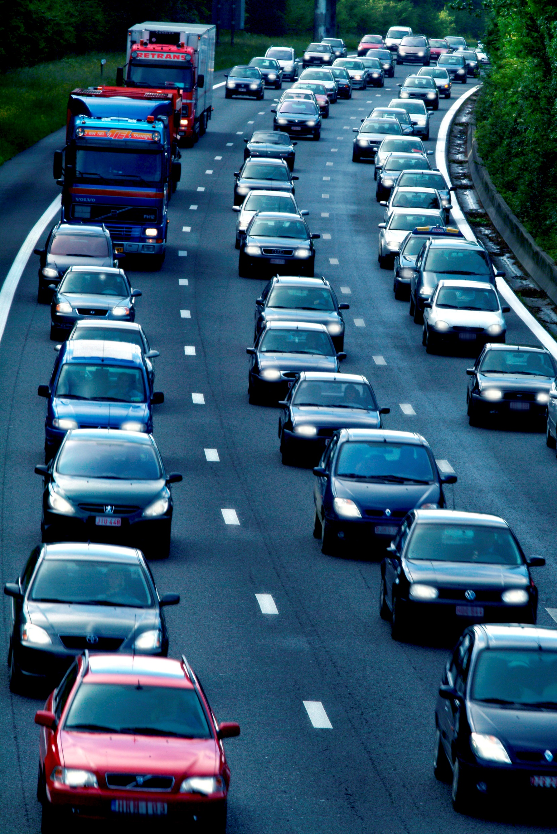
Multimodal transport
Maritime, aviation and road sectors produce the most emissions
90% reduction of transport emissions is needed by 2050
Implementation of sustainable and smart mobility strategy
Multimodal transport: Combining of multiple transport modes throughout a journey to reduce emissions

Slide 4
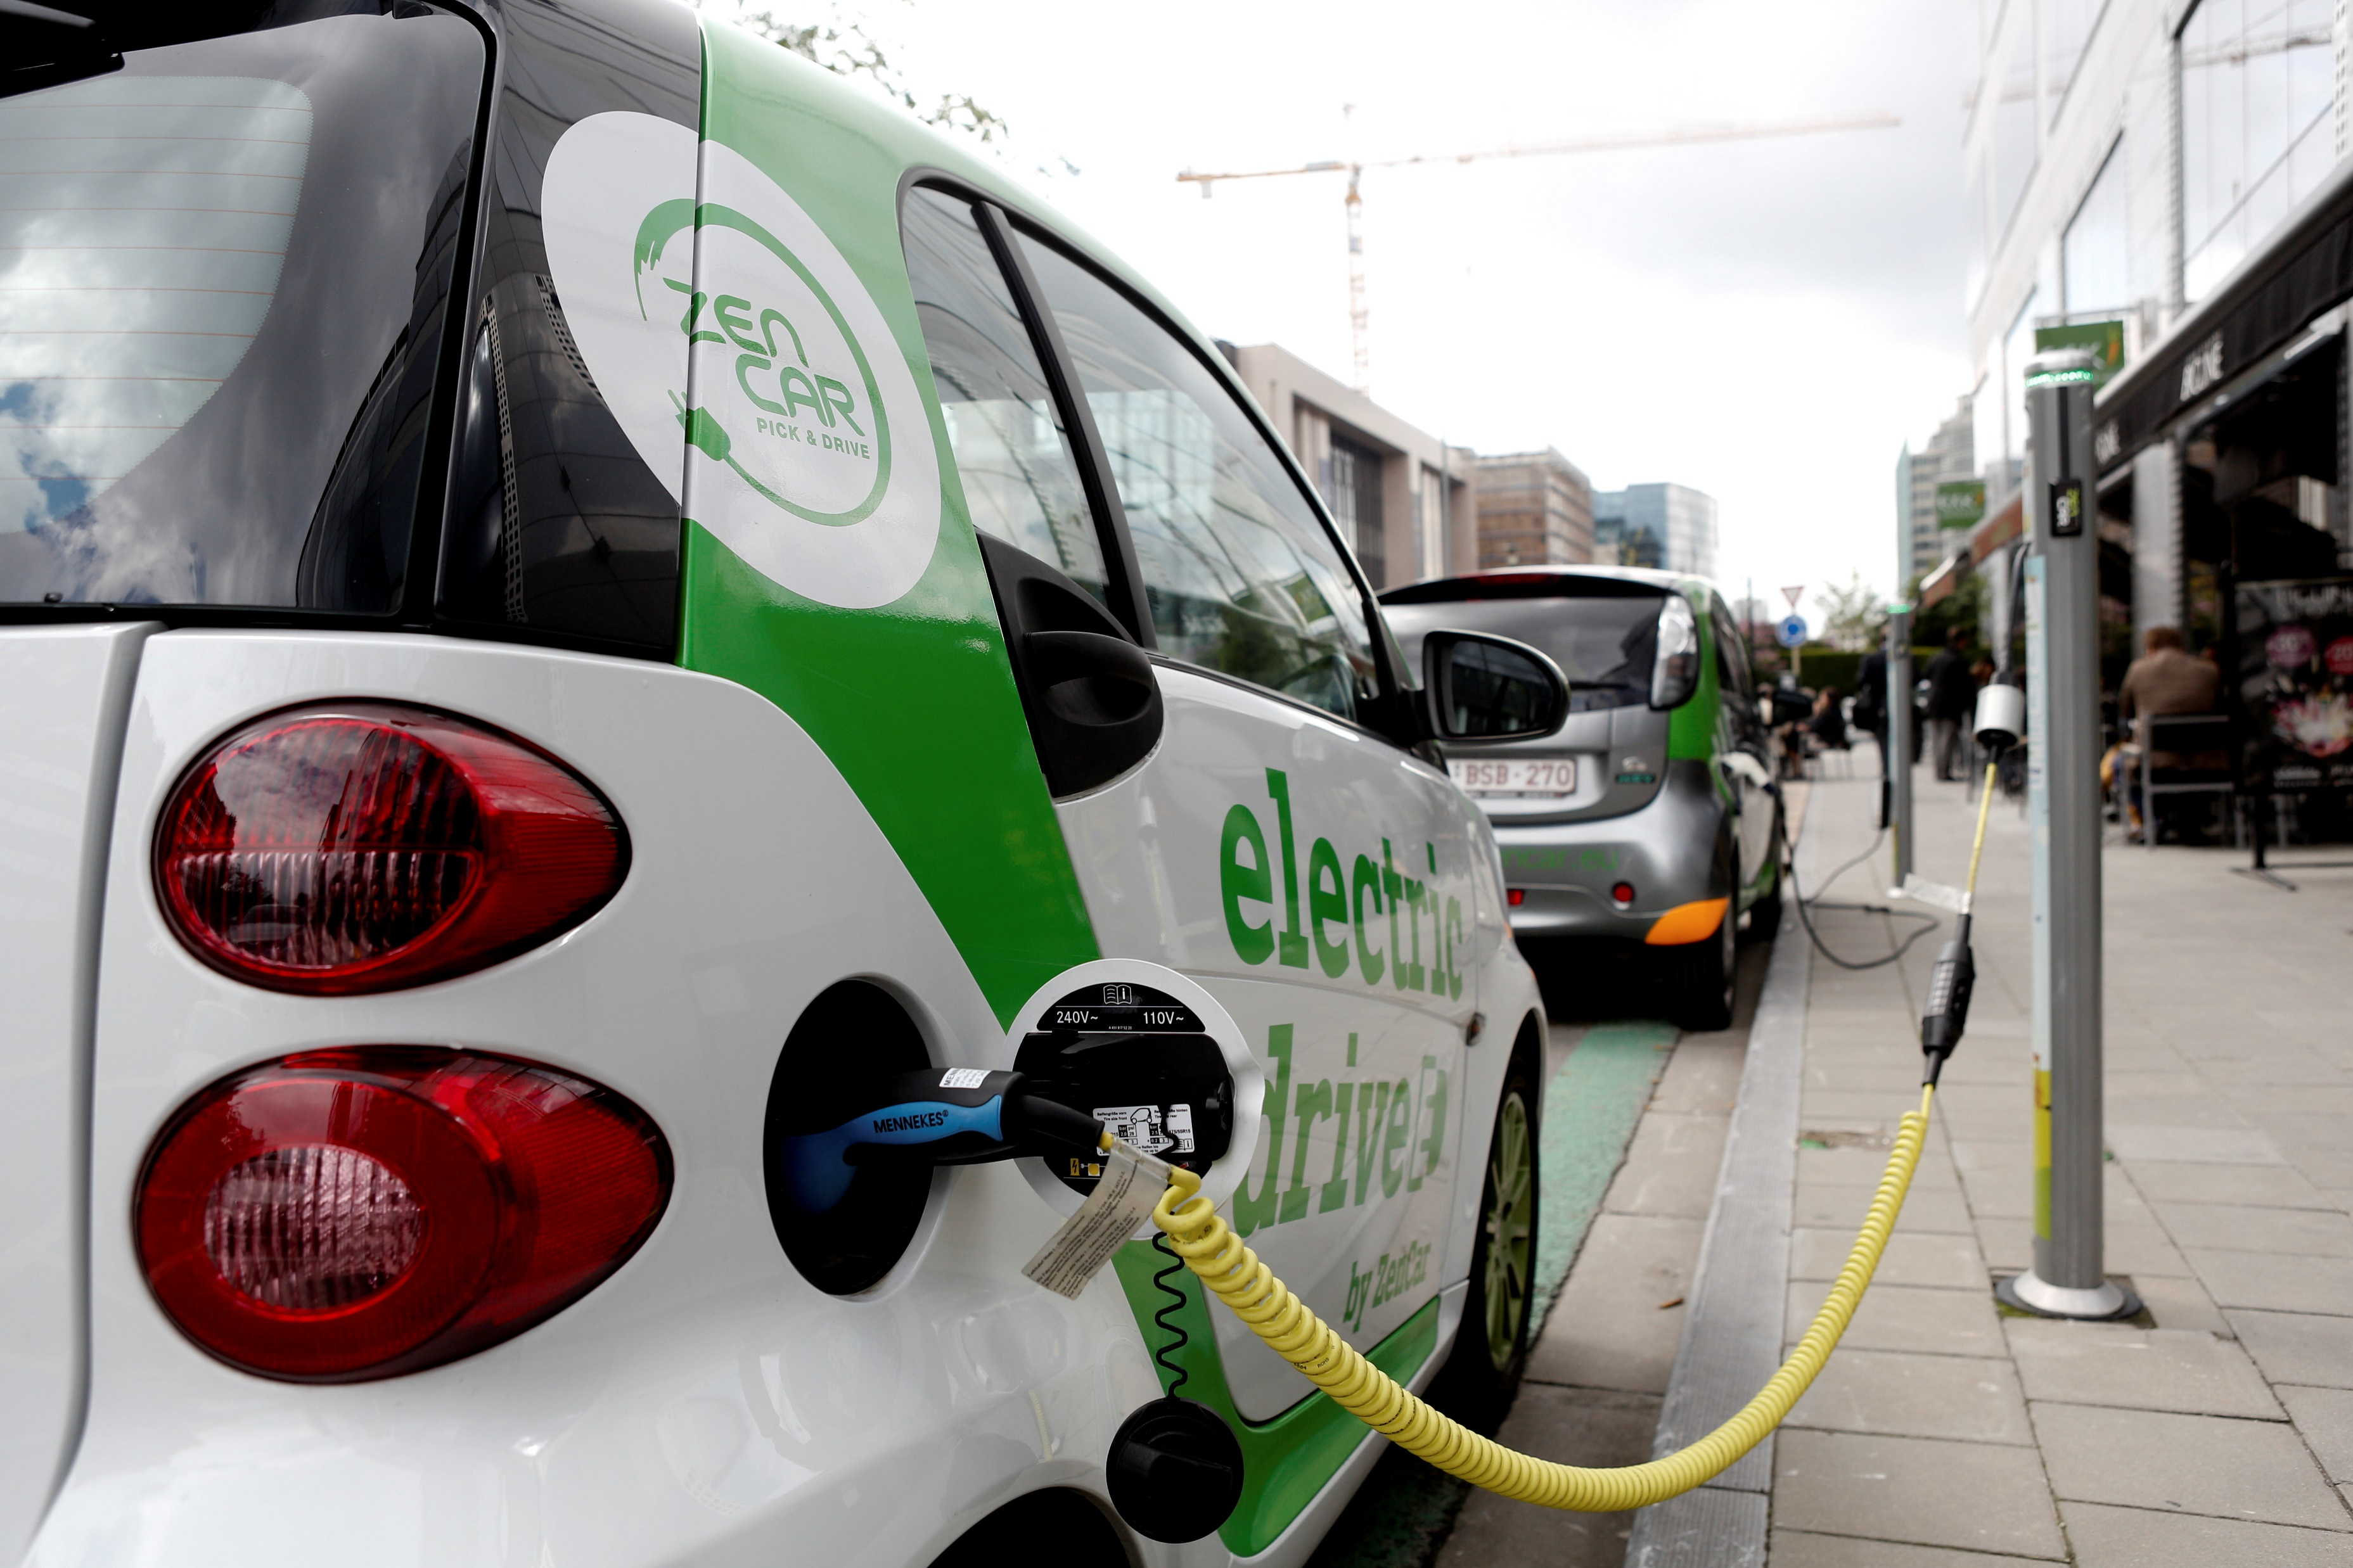
Alternative fuels
Sustainable alternative fuels
Revision of the Alternative Fuels Infrastructure Directive
Funding call to support deployment of public recharging and refueling points
Increasing production and deployment of these more sustainable alternative fuels

Slide 5
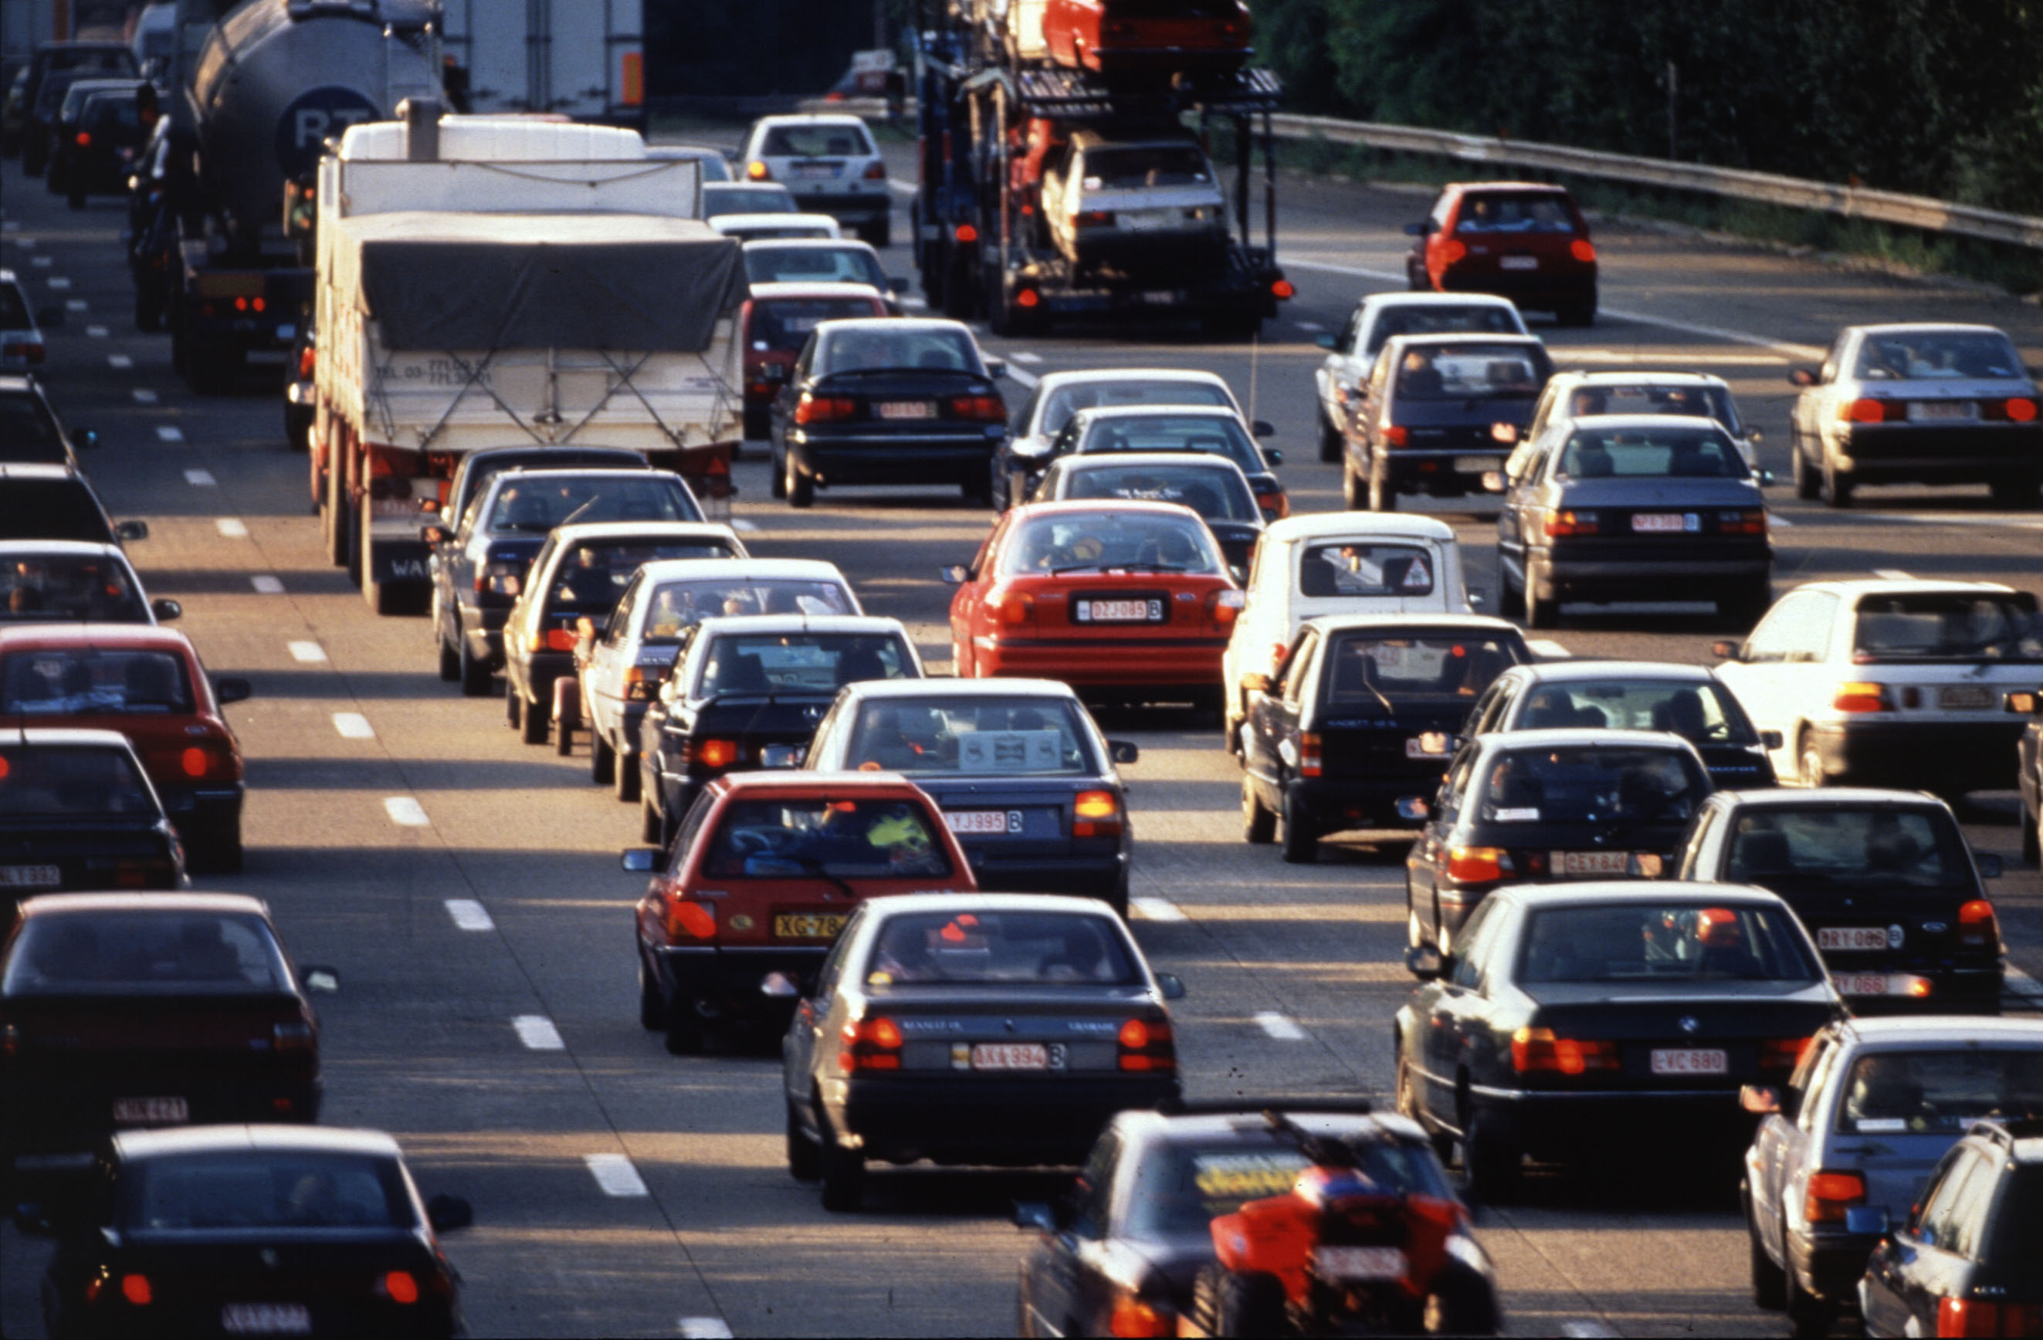
Smart traffic management systems
Effective traffic management can help reduce congestion and pollution
Implement smart traffic management systems
Transport system and infrastructure must harness digitalisation

Slide 6
Reflect environmental impact in price
Price of transport should reflect environmental impact
Help consumer make informed choices
Ensure this does not disproportionally impact certain MS / citizens
Extending the Emissions Trading System

