Slide 1
Zero pollution
Climate ambition
Biodiversity
Energy
A European Green Deal
Food
Circular economy
Mobility
Building

Slide 2
Circular economy
Industry accounts for 20% of the EU’s GHG emissions
Modernising energy-intensive industries
Empower consumers
Resource-intensive industries
Innovation to develop sustainable technologies

Slide 3
Modernising energy-intensive industries
Steel, chemicals and cement industries account for 14% of the EU’s GHG emissions
Supply key value chains
Indispensable to the economy

Slide 4
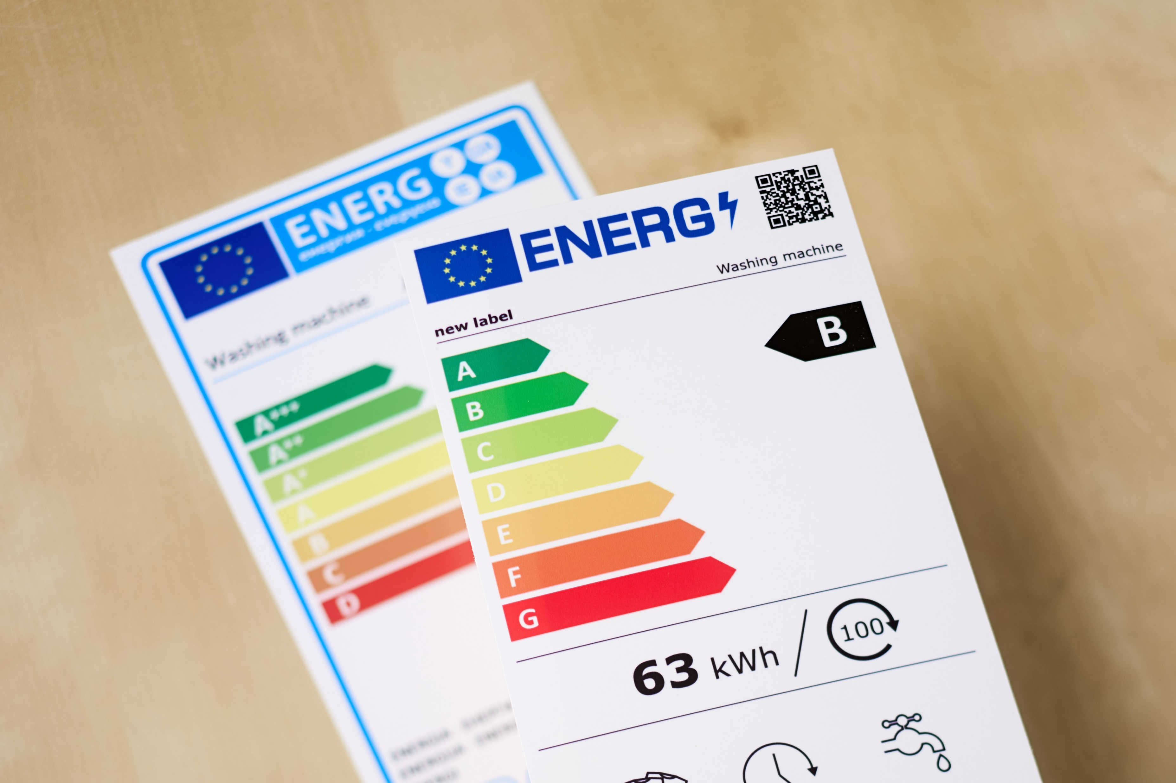
Empower consumers
Change the way we consume
Businesses must offer sustainable products
Communicate clear, reliable information regarding the environmental impact
E.g. an electronic product passport
Tackle false green claims by increasing monitoring efforts

Slide 5
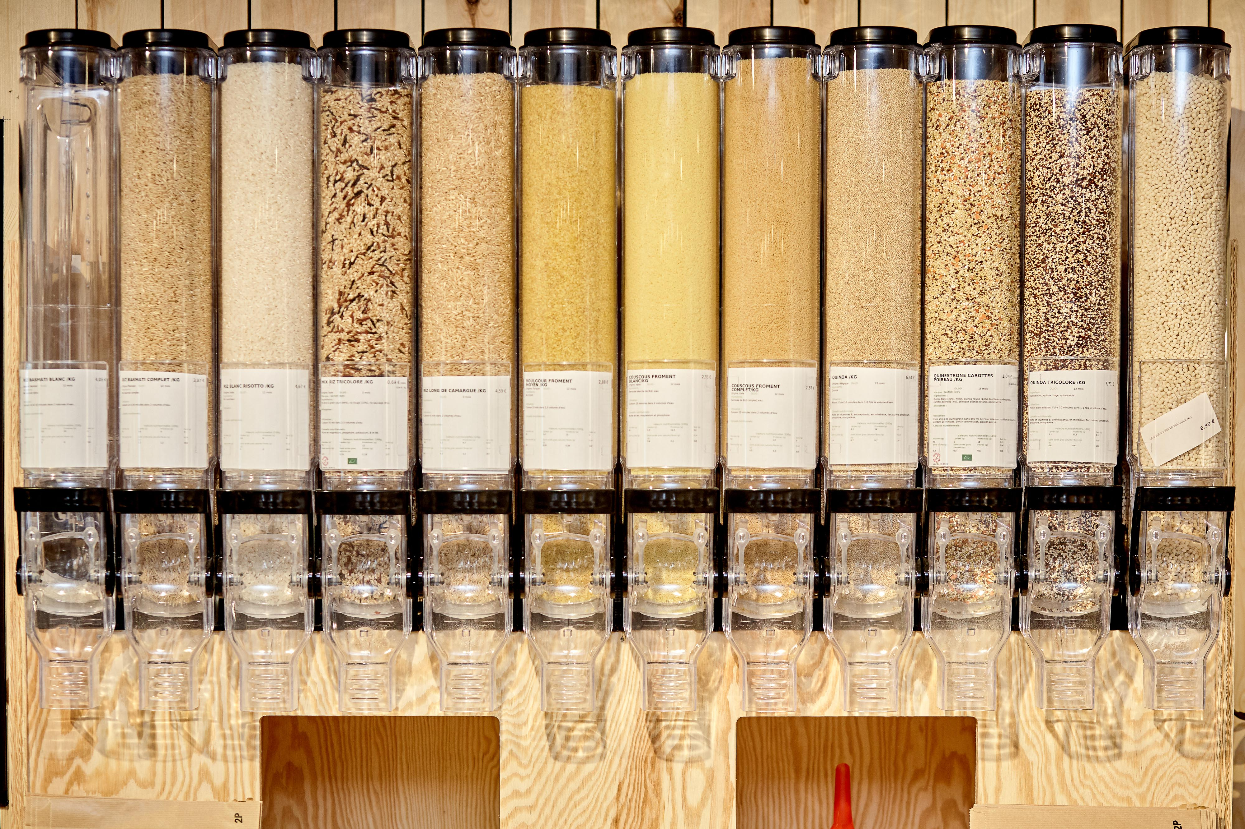

Resource intensive industries
Circular economy action plan focuses on resource-intensive industries:
Textiles
Construction
Electronics
Plastics
Sustainable products policy
Common methodology and principles for all product design
All packaging reusable or recyclable by 2030

Slide 6

Innovation to develop sustainable technologies
Commission is aiming to encourage and invest in innovation such as:
Zero-carbon steel making process
Circular battery value chain

Slide 7
Building
Buildings accounts for 40% of energy consumption within the EU
Products & processes in line with circular economy
Increase renovation rate
Provide technical assistance
Uptake of latest technologies in renovation/construction

Slide 8
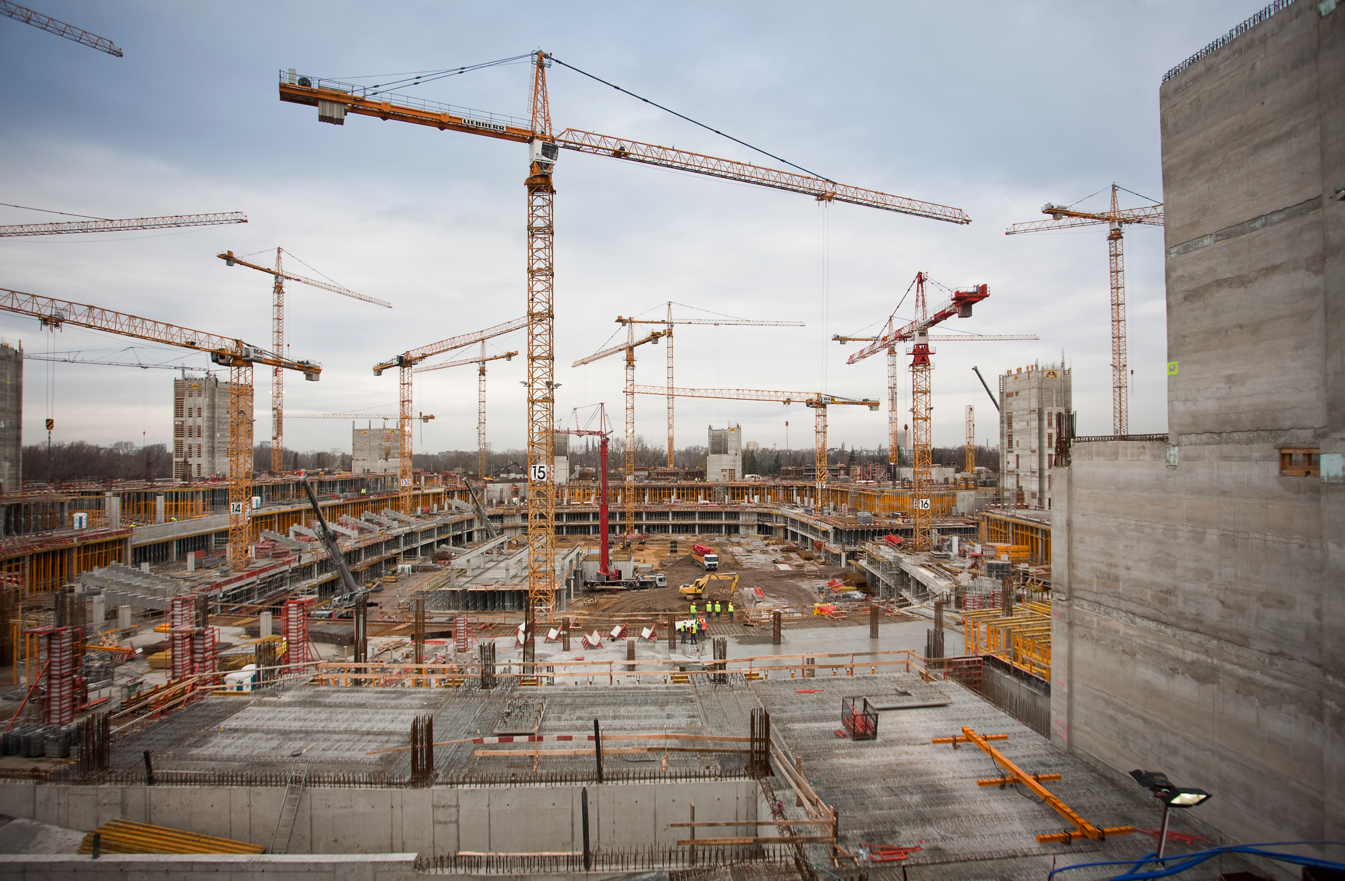
Products & processes in line with circular economy
Products used in renovation/construction must be in line with circular economy principles
Durable, repairable, recyclable
Processes of construction must also be environmentally friendly
Zero-carbon steel making process

Slide 9
Increase renovation rate
‘Renovation wave’ published in October 2020
double the rate renovation rate of building stock in the next 10 years
Current rate (0,4-1,2%) is much too low to meet 2050 targets
Money saved through increasing energy efficiency in public buildings can be invested elsewhere
Reducing the energy bills in schools & hospitals allows for investing in better education and healthcare
Renovation must tackle ‘energy poverty’
50 million people struggle to keep their homes warm

Slide 10
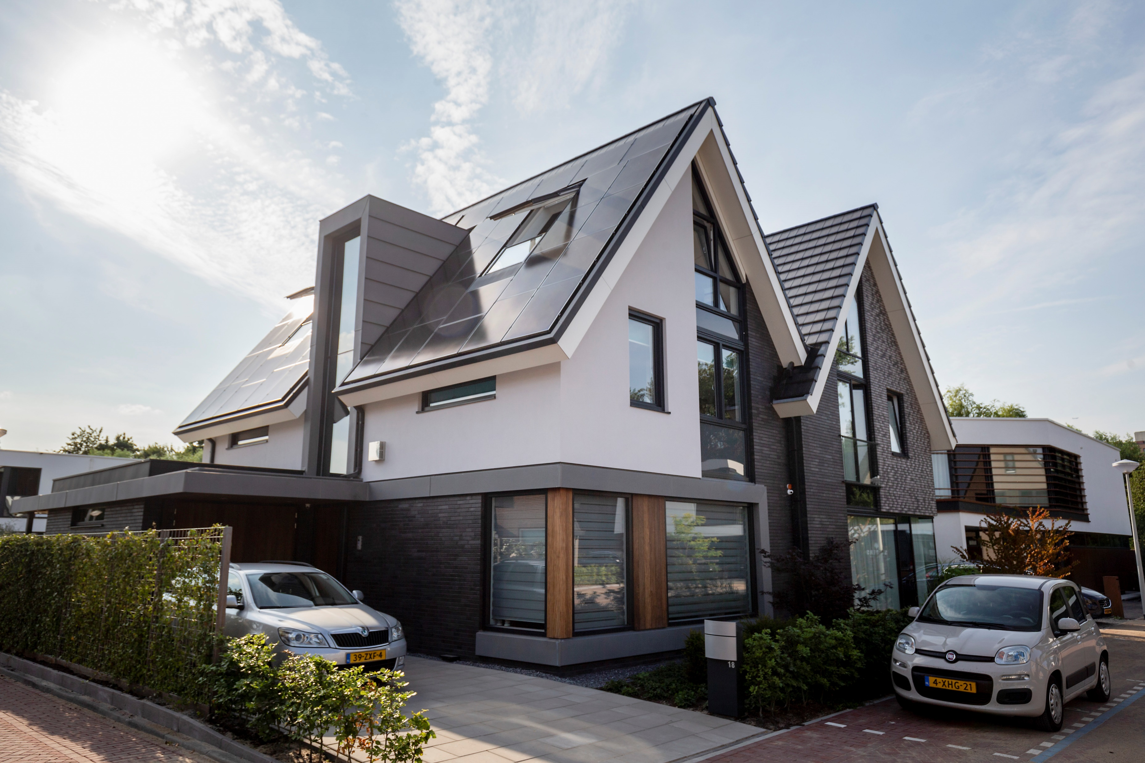
Increase renovation rate
Renovation is costly…
Financing schemes to support renovation projects → InvestEU
Large scale renovation efforts, focused primarily on social housing
Harmonise design and sustainability: New European Bauhaus
Projects & discussion for a to bring together sustainable architecture and aesthetics

Slide 11

Provide technical assistance
Funding should be accompanied by technical assistance for preparation and implementation
Strengthening of existing facilities such as European Local Energy Assistance (ELENA)
Allocations from Resilience and Recovery Facility
Ensure the uptake of latest technologies in any renovation/construction project
Green & digital transitions

